Slide 1
6
C Arrays

Slide 2
OBJECTIVES
In this chapter you will learn:
To use the array data structure to represent lists of values.
To define an array, initialize an array and refer to individual elements of an array.
To define symbolic constants.

Slide 3
6.1 Introduction
6.2 Arrays
6.3 Defining Arrays
6.4 Array Examples

Slide 4
6.1 Introduction
Arrays
  Structures of related data items
  Static entity – same size throughout program
  Dynamic data structures discussed in Chapter 12

Slide 5
6.2 Arrays
Array
  Group of consecutive memory locations
  Same name and type
To refer to an element, specify
  Array name
  Position number
Format:
    arrayname[ position number ]
  First element at position 0
  n element array named c:
    c[ 0 ], c[ 1 ]...c[ n – 1 ]

Slide 6
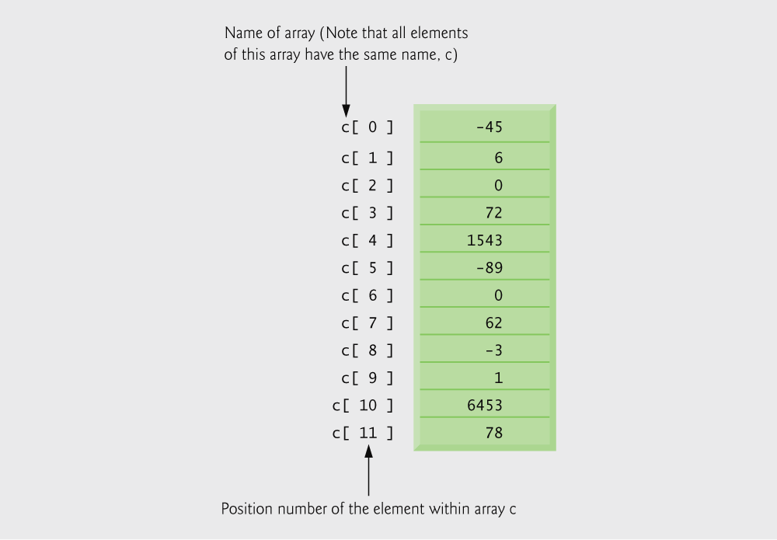
Fig. 6.1 | 12-element array.

Slide 7
6.2 Arrays
Array elements are like normal variables
    c[ 0 ] = 3;
    printf( "%d", c[ 0 ] );
  Perform operations in subscript. If x equals 3
    c[ 5 - 2 ] == c[ 3 ] == c[ x ]

Slide 8
Common Programming Error 6.1
It is important to note the difference between the “seventh element of the array” and “array element seven.” Because array subscripts begin at 0, the “seventh element of the array” has a subscript of 6, while “array element seven” has a subscript of 7 and is actually the eighth element of the array. This is a source of “off-by-one” errors.

Slide 9
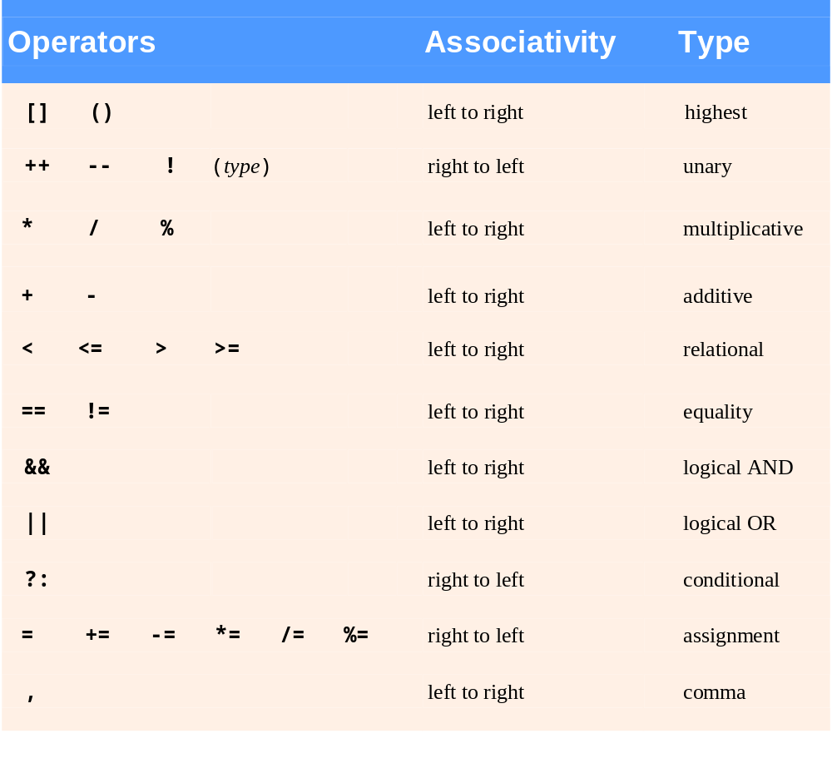
Fig. 6.2 | Operator precedence.

Slide 10
6.3 Defining Arrays
When defining arrays, specify
  Name
  Type of array
  Number of elements
    arrayType arrayName[ numberOfElements ];
  Examples:
    int c[ 10 ];
    float myArray[ 3284 ];
Defining multiple arrays of same type
  Format similar to regular variables
  Example:
    int b[ 100 ], x[ 27 ];

Slide 11
6.4 Array Examples
Initializers
    int n[ 5 ] = { 1, 2, 3, 4, 5 };
  If not enough initializers, rightmost elements become 0
      int n[ 5 ] = { 0 }
    All elements 0
  If too many initializers, a syntax error occurs
  C arrays have no bounds checking
If size omitted, initializers determine it
    int n[ ] = { 1, 2, 3, 4, 5 };
  5 initializers, therefore 5 element array

Slide 12
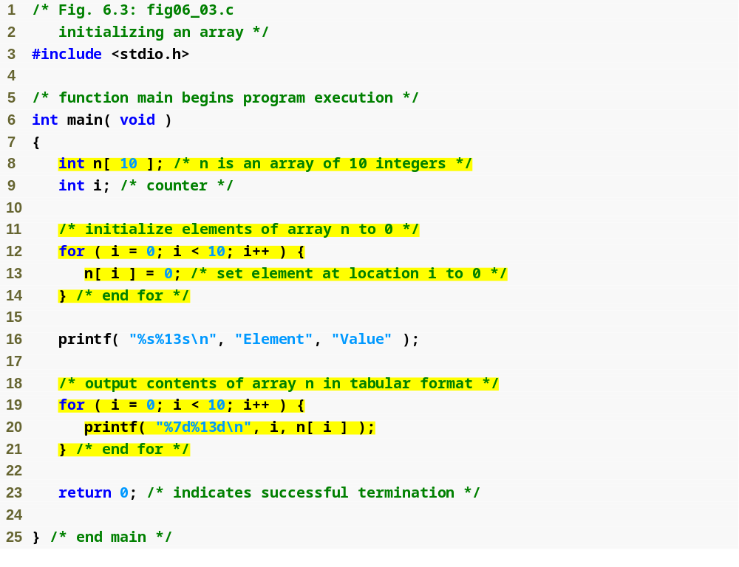
Outline
fig06_03.c
(1 of 2 )
for loop initializes each array element separately
for loop outputs all array elements

Slide 13
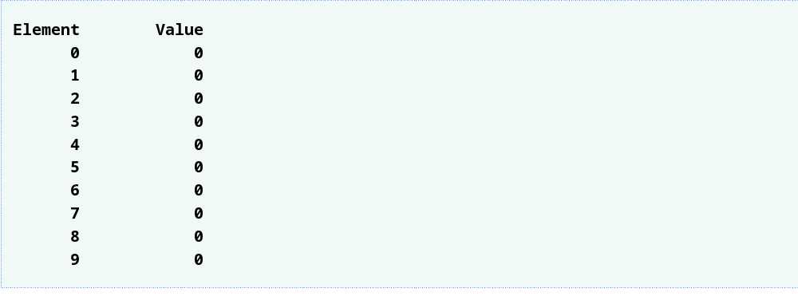
Outline
fig06_03.c
(2 of 2 )

Slide 14
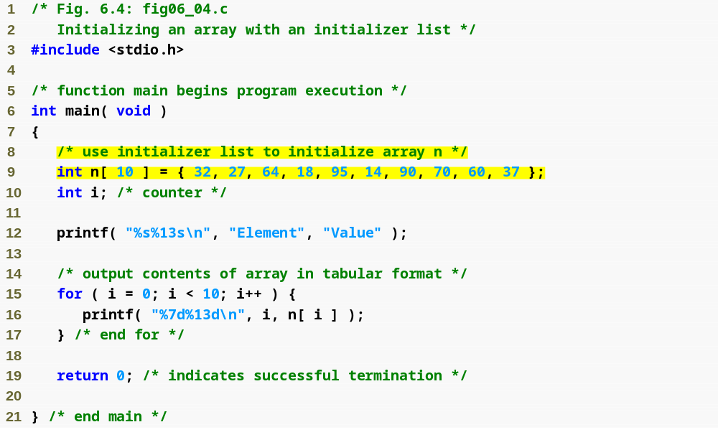
Outline
fig06_04.c
(1 of 2 )
initializer list initializes all array elements simultaneously

Slide 15
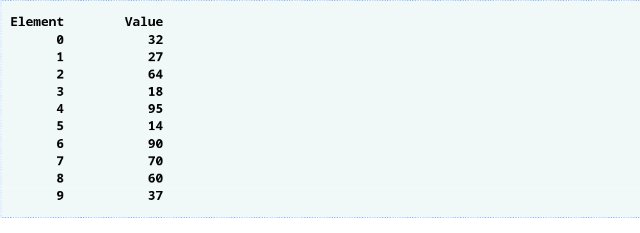
Outline
fig06_04.c
(2 of 2 )

Slide 16
Common Programming Error 6.2
Forgetting to initialize the elements of an
array whose elements should be initialized.

Slide 17
Common Programming Error 6.3
Providing more initializers in an array
initializer list than there are elements
in the array is a syntax error.

Slide 18
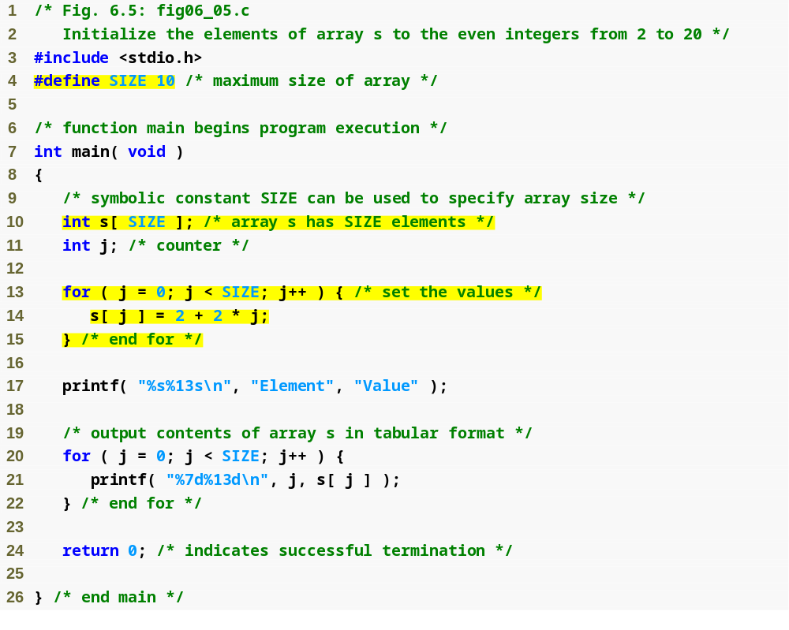
Outline
#define directive tells compiler to replace all instances of the word SIZE with 10
fig06_05.c
(1 of 2 )
SIZE is replaced with 10 by the compiler, so array s has 10 elements
for loop initializes each array element separately

Slide 19
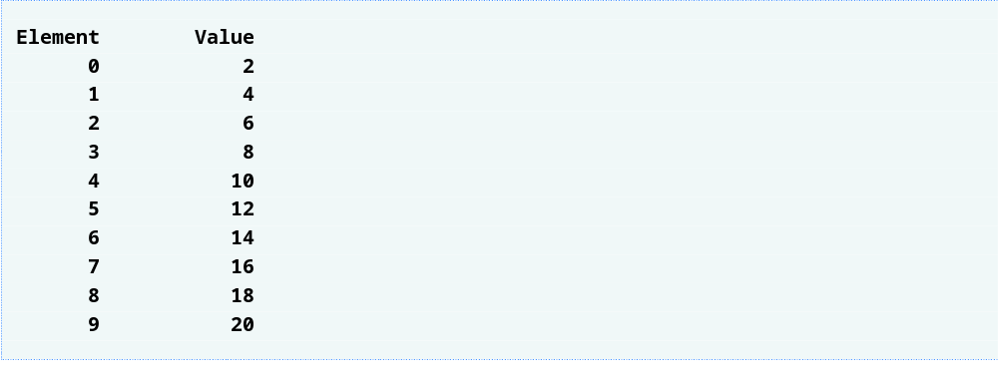
Outline
fig06_05.c
(2 of 2 )

Slide 20
Common Programming Error 6.4
Ending a #define or #include preprocessor directive with a semicolon. Remember that preprocessor directives are not C statements.

Slide 21
Common Programming Error 6.5
Assigning a value to a symbolic constant in
an executable statement is a syntax error.
A symbolic constant is not a variable. No
space is reserved for it by the compiler as with variables that hold values at execution time.

Slide 22
Software Engineering Observation 6.1
Defining the size of each array as a symbolic constant makes programs more scalable.

Slide 23
Good Programming Practice 6.1
Use only uppercase letters for symbolic constant names. This makes these constants stand out in a program and reminds you that symbolic constants are not variables.

Slide 24
Good Programming Practice 6.2
In multiword symbolic constant names, use underscores to separate the words for readability.

Slide 25
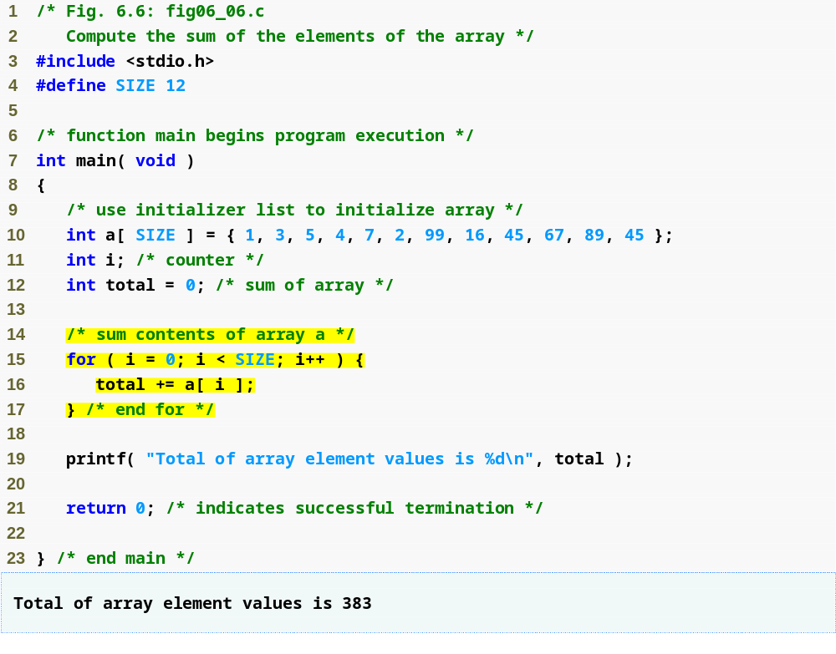
Outline
fig06_06.c
initializer list initializes all array elements simultaneously
for loop adds each element of the array to variable total

Slide 26
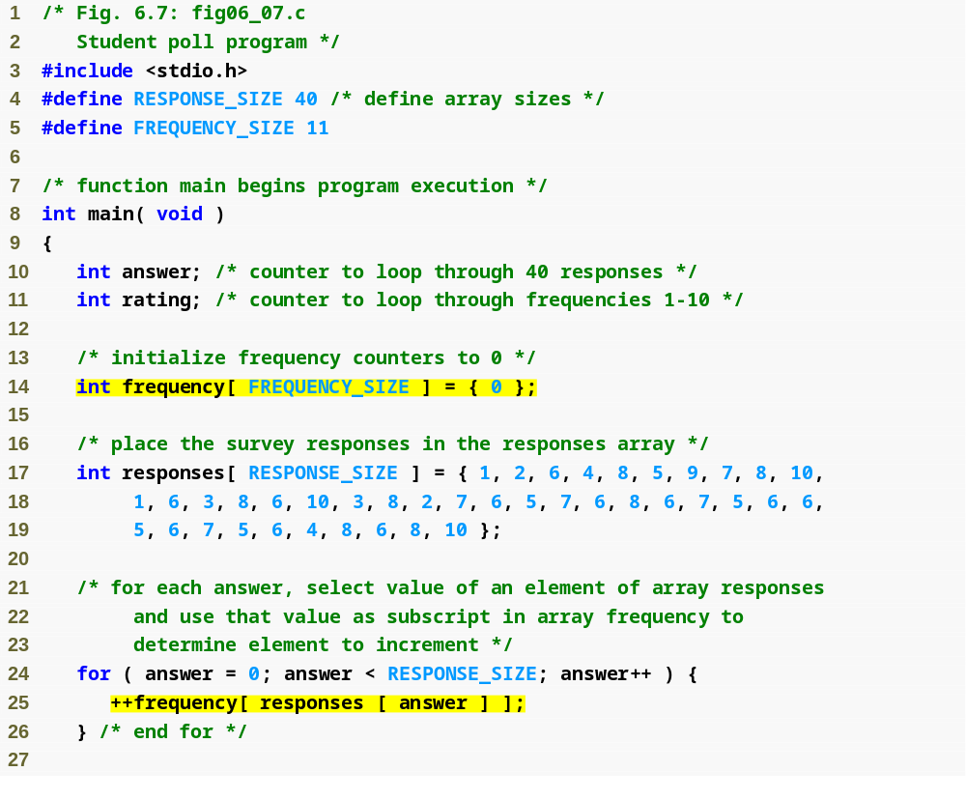
Outline
#define directives create symbolic constants
fig06_07.c
(1 of 2 )
frequency array is defined with 11 elements
responses array is defined with 40 elements and its elements are initialized
subscript of frequency array is given by value in responses array

Slide 27
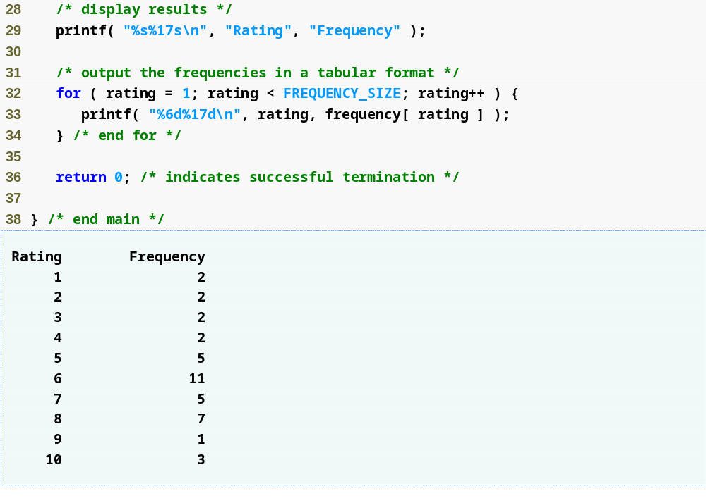
Outline
fig06_07.c
(2 of 2 )

Slide 28
Good Programming Practice 6.3
Strive for program clarity. Sometimes it may be worthwhile to trade off the most efficient use of memory or processor time in favor of writing clearer programs.

Slide 29
Performance Tip 6.1
Sometimes performance considerations
far outweigh clarity considerations.

Slide 30
Common Programming Error 6.6
Referring to an element outside the array bounds.

Slide 31
Error-Prevention Tip 6.1
When looping through an array, the array subscript should never go below 0 and should always be less than the total number of elements in the array (size – 1). Make sure the loop-terminating condition prevents accessing elements outside this range.

Slide 32
Error-Prevention Tip 6.2
Programs should validate the correctness of all input values to prevent erroneous information from affecting a program’s calculations.

Slide 33
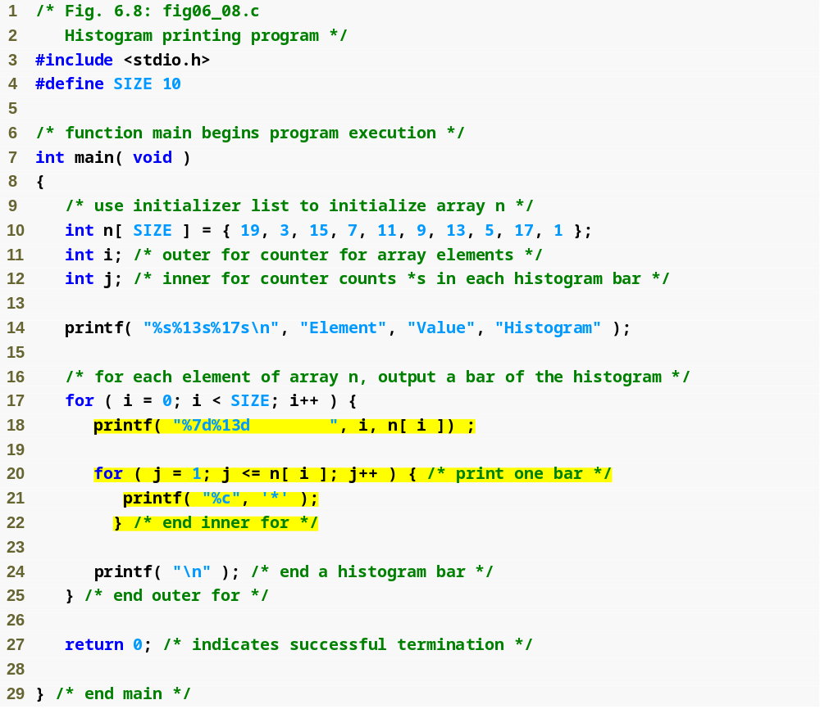
Outline
fig06_08.c
(1 of 2 )
nested for loop prints n[ i ] asterisks on the ith line

Slide 34
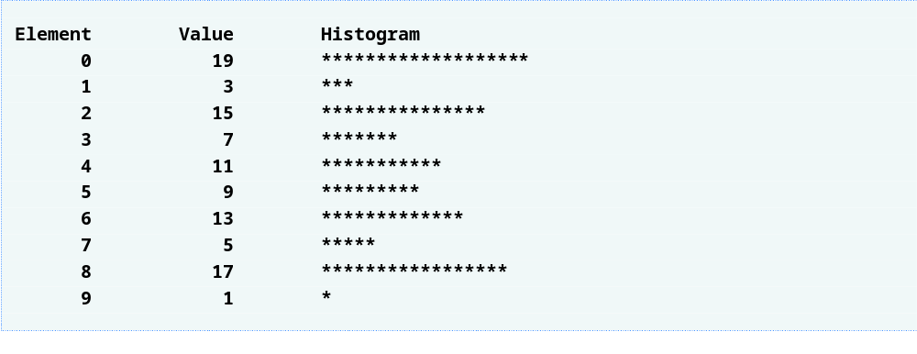
Outline
fig06_08.c
(2 of 2 )

Slide 35
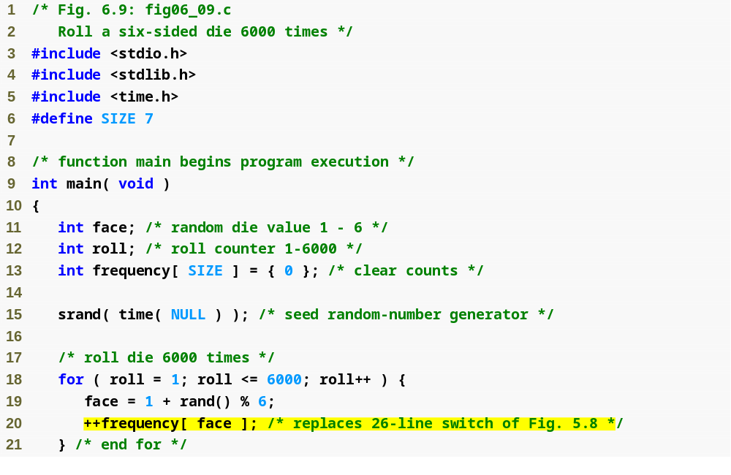
Outline
fig06_09.c
(1 of 2 )
for loop uses one array to track number of times each number is rolled instead of using 6 variables and a switch statement

Slide 36
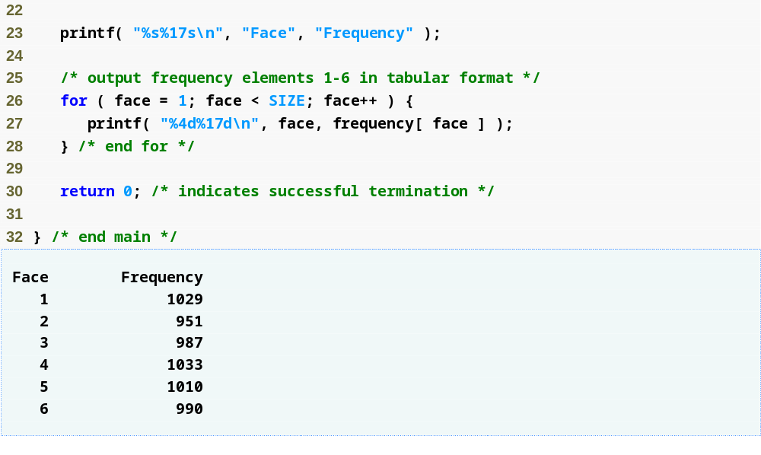
Outline
fig06_09.c
(2 of 2 )

Slide 37
Performance Tip 6.2
In functions that contain automatic arrays where the function is in and out of scope frequently, make the array static so it is not created each time the function is called.

Slide 38
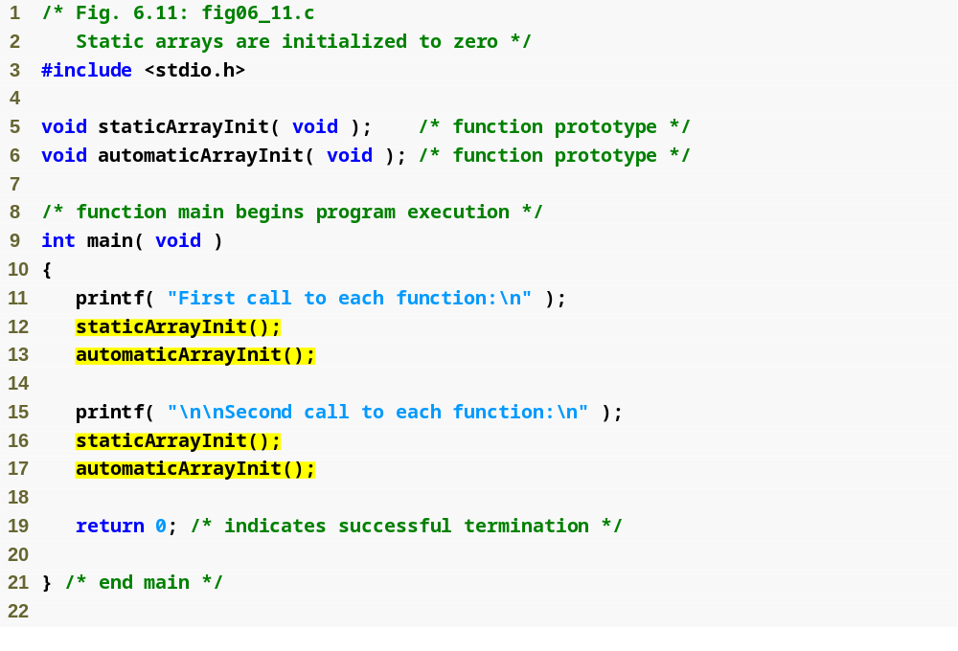
Outline
fig06_11.c
(1 of 4 )

Slide 39
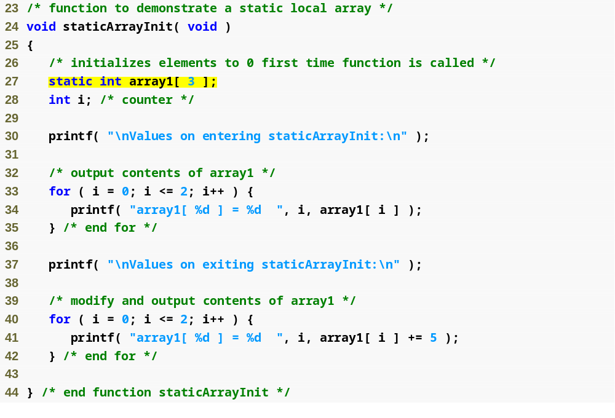
Outline
static array is created only once, when staticArrayInit is first called
fig06_11.c
(2 of 4 )

Slide 40
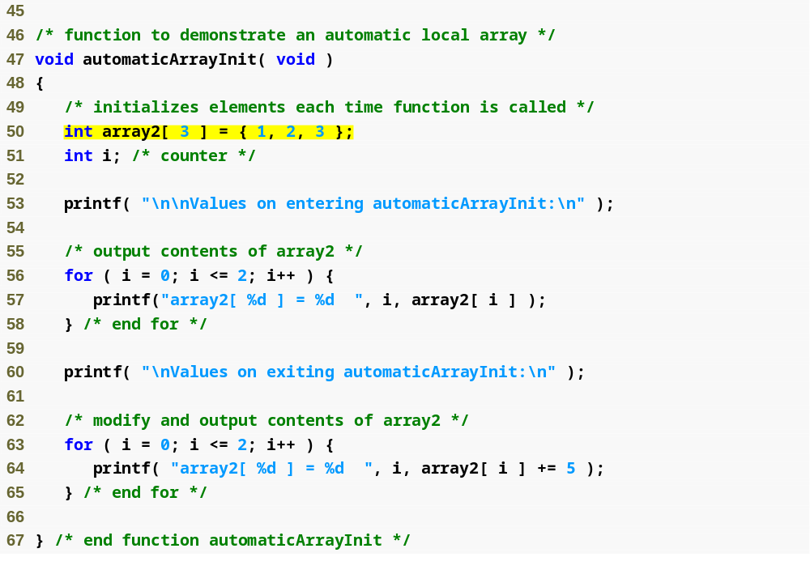
Outline
automatic array is recreated every time automaticArrayInit is called
fig06_11.c
(3 of 4 )

Slide 41
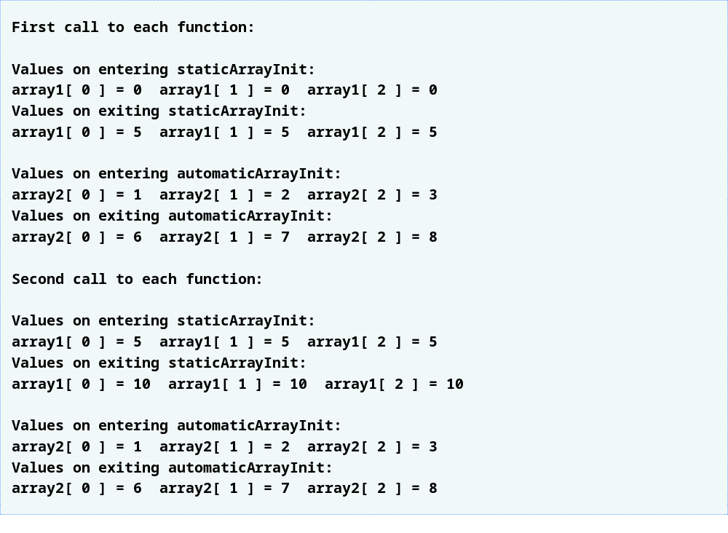
Outline
fig06_11.c
(4 of 4 )

Slide 42
Common Programming Error 6.8
Assuming that elements of a local static
array are initialized to zero every time the function in which the array is defined is called.

